Slide 1
Intel Image
Classification
CNN from Scratch vs. Transfer Learning (MobileNetV2)
6 Classes • ~17,000 Images • 100×100 px
Malak Mohamed Salah – 230102892
Mohamed Nasser – 230102231
Sama seraj - 240103344

Slide 2
Agenda
01
Dataset
02
Preprocessing
Intel 6-class scene images
Normalization & augmentation
03
CNN from Scratch
04
Transfer Learning
Custom 4-block architecture
MobileNetV2 fine-tuning
05
Results & Comparison
06
Conclusion
Metrics, charts, confusion matrix
Findings & recommendations
2

Slide 3
Dataset — Intel Image Classification
6 natural scene categories:
Data Split (70 / 15 / 15):
Buildings — urban architecture
Forest — woodland / trees
Glacier — icy landscapes
Mountain — rocky terrain
Sea — ocean & coastal scenes
Street — urban roads
Split | Images | %
Training | ~11,900 | 70%
Validation | ~2,550 | 15%
Test | ~2,550 | 15%
Total | ~17,000 | 100%
Total images: ~17,000
Balanced classes (~2,833 each)
Zero corrupted files
Original split: seg_train + seg_test
3

Slide 4
Preprocessing & Augmentation
Pipeline Steps:
Augmentation (Train Only):
Resize all images to 100 × 100 px
Normalize pixels [0,255] → [0.0, 1.0]
Integrity check — 0 corrupted files found
Apply augmentation on training set only
Val & Test: rescale only (no augmentation)
Batch size = 32 | Shuffle training set
Transform | Value
Rotation | ± 20°
Width shift | ± 10%
Height shift | ± 10%
Horizontal flip | Enabled
Zoom | ± 10%
Brightness | [0.8 – 1.2]
Fill mode | Nearest
4

Slide 5
Model 1 — CNN from Scratch
Architecture:
Training Config:
Block | Details
Input | 100 × 100 × 3 RGB
Conv Block 1 | 2× Conv(32) + BN + MaxPool + Dropout(0.25)
Conv Block 2 | 2× Conv(64) + BN + MaxPool + Dropout(0.25)
Conv Block 3 | 2× Conv(128) + BN + MaxPool + Dropout(0.30)
Conv Block 4 | Conv(256) + BN + MaxPool + Dropout(0.30)
Dense 1 | 512 units + Dropout(0.50)
Dense 2 | 256 units + Dropout(0.40)
Output | 6 units — Softmax
Optimizer: Adam (lr = 0.001)
Loss: Categorical Cross-Entropy
Max Epochs: 25
EarlyStopping: patience = 5
ReduceLROnPlateau: factor = 0.2
Parameters: ~3.2M
5

Slide 6
Model 2 — Transfer Learning (MobileNetV2)
Custom Head on MobileNetV2:
Two-Phase Training:
Layer | Details
Input | 100 × 100 × 3 RGB
MobileNetV2 base | ImageNet pre-trained weights
GlobalAvgPool2D | Spatial pooling
Dense(256) + BN | ReLU + BatchNorm
Dropout(0.50) | Regularization
Dense(128) | ReLU activation
Dropout(0.30) | Regularization
Output Dense(6) | Softmax — 6 classes
Phase 1 — Feature Extraction
Base layers: FROZEN
Train head only
Up to 10 epochs
LR = 0.0001
Phase 2 — Fine-Tuning
Last 30 layers: UNFROZEN
Full model trained
Up to 25 epochs
ReduceLR + EarlyStopping
6

Slide 7
Evaluation Results
~85%
~92%
CNN Scratch
Accuracy
MobileNetV2
Accuracy
7

Slide 8
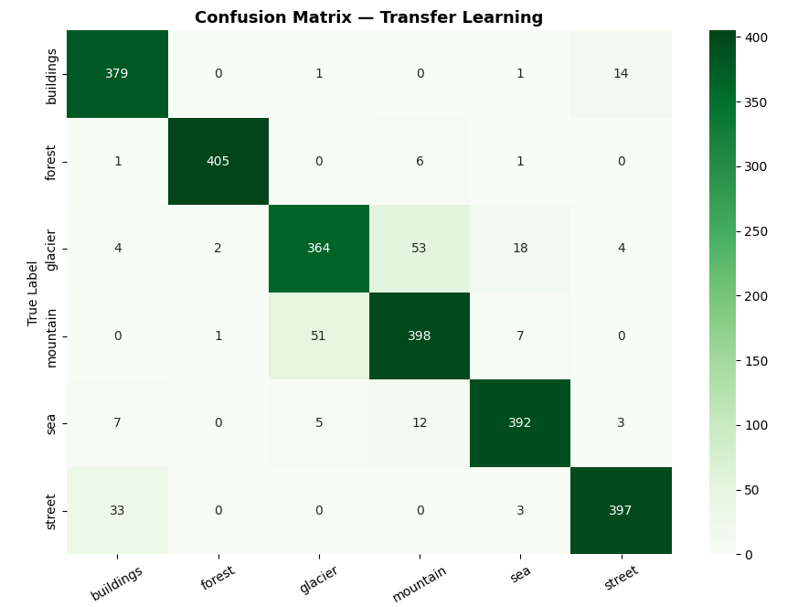
Per-Class F1-Score & Confusion Matrix
Confusion Matrix Observations:
Forest: easiest class (high recall both models)
Glacier ↔ Mountain: most confused pair
Street ↔ Buildings: secondary issue
Transfer Learning reduces all off-diagonal errors
Insert confusion matrix
images from results/ folder
8

Slide 9
Model Comparison
Metric | CNN from Scratch | MobileNetV2
Test Accuracy | ~83–86% | ~91–93%
F1-Score (weighted) | ~83% | ~91%
Precision (weighted) | ~84% | ~92%
Recall (weighted) | ~83% | ~91%
Training Time | ~15–25 min | ~20–35 min
Parameters | ~3.2M | ~2.6M
Pre-trained weights | No | Yes (ImageNet)
Convergence speed | Slower | Faster
9

Slide 10
Conclusion
Key Findings:
MobileNetV2 outperforms CNN Scratch on all metrics (~92% vs ~85% accuracy)
Transfer Learning converges faster — pre-trained ImageNet features give a strong start
Glacier & Mountain are the hardest classes to separate (visually similar)
Balanced dataset + augmentation prevented overfitting in both models
CNN Scratch still achieves strong results (>83%)
10

Slide 11
Thank You
Intel Image Classification • CNN Scratch vs. MobileNetV2
6 Classes • ~17K Images • Transfer Learning wins (~92%)

